Slide 1
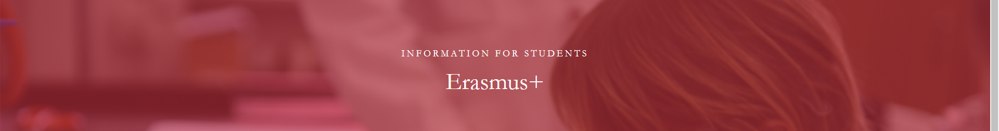

Erasmus info meeting
Department of pre-primary and primary education
COURSES
WINTER SEMESTR 2025/2026

Slide 2
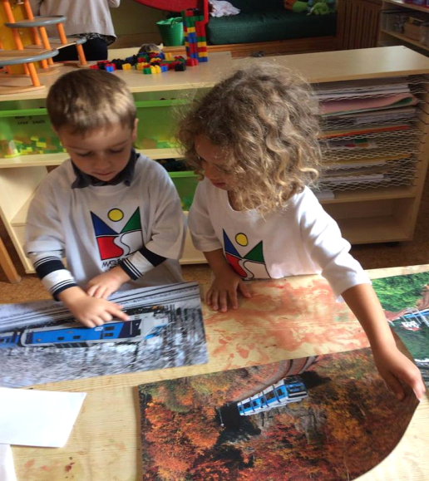
Contact person and information
Department of pre-primary
and primary education
PhDr. Barbora Loudová Stralczynská, Ph.D. (R223) barbora.loudova@pedf.cuni.cz

Slide 3
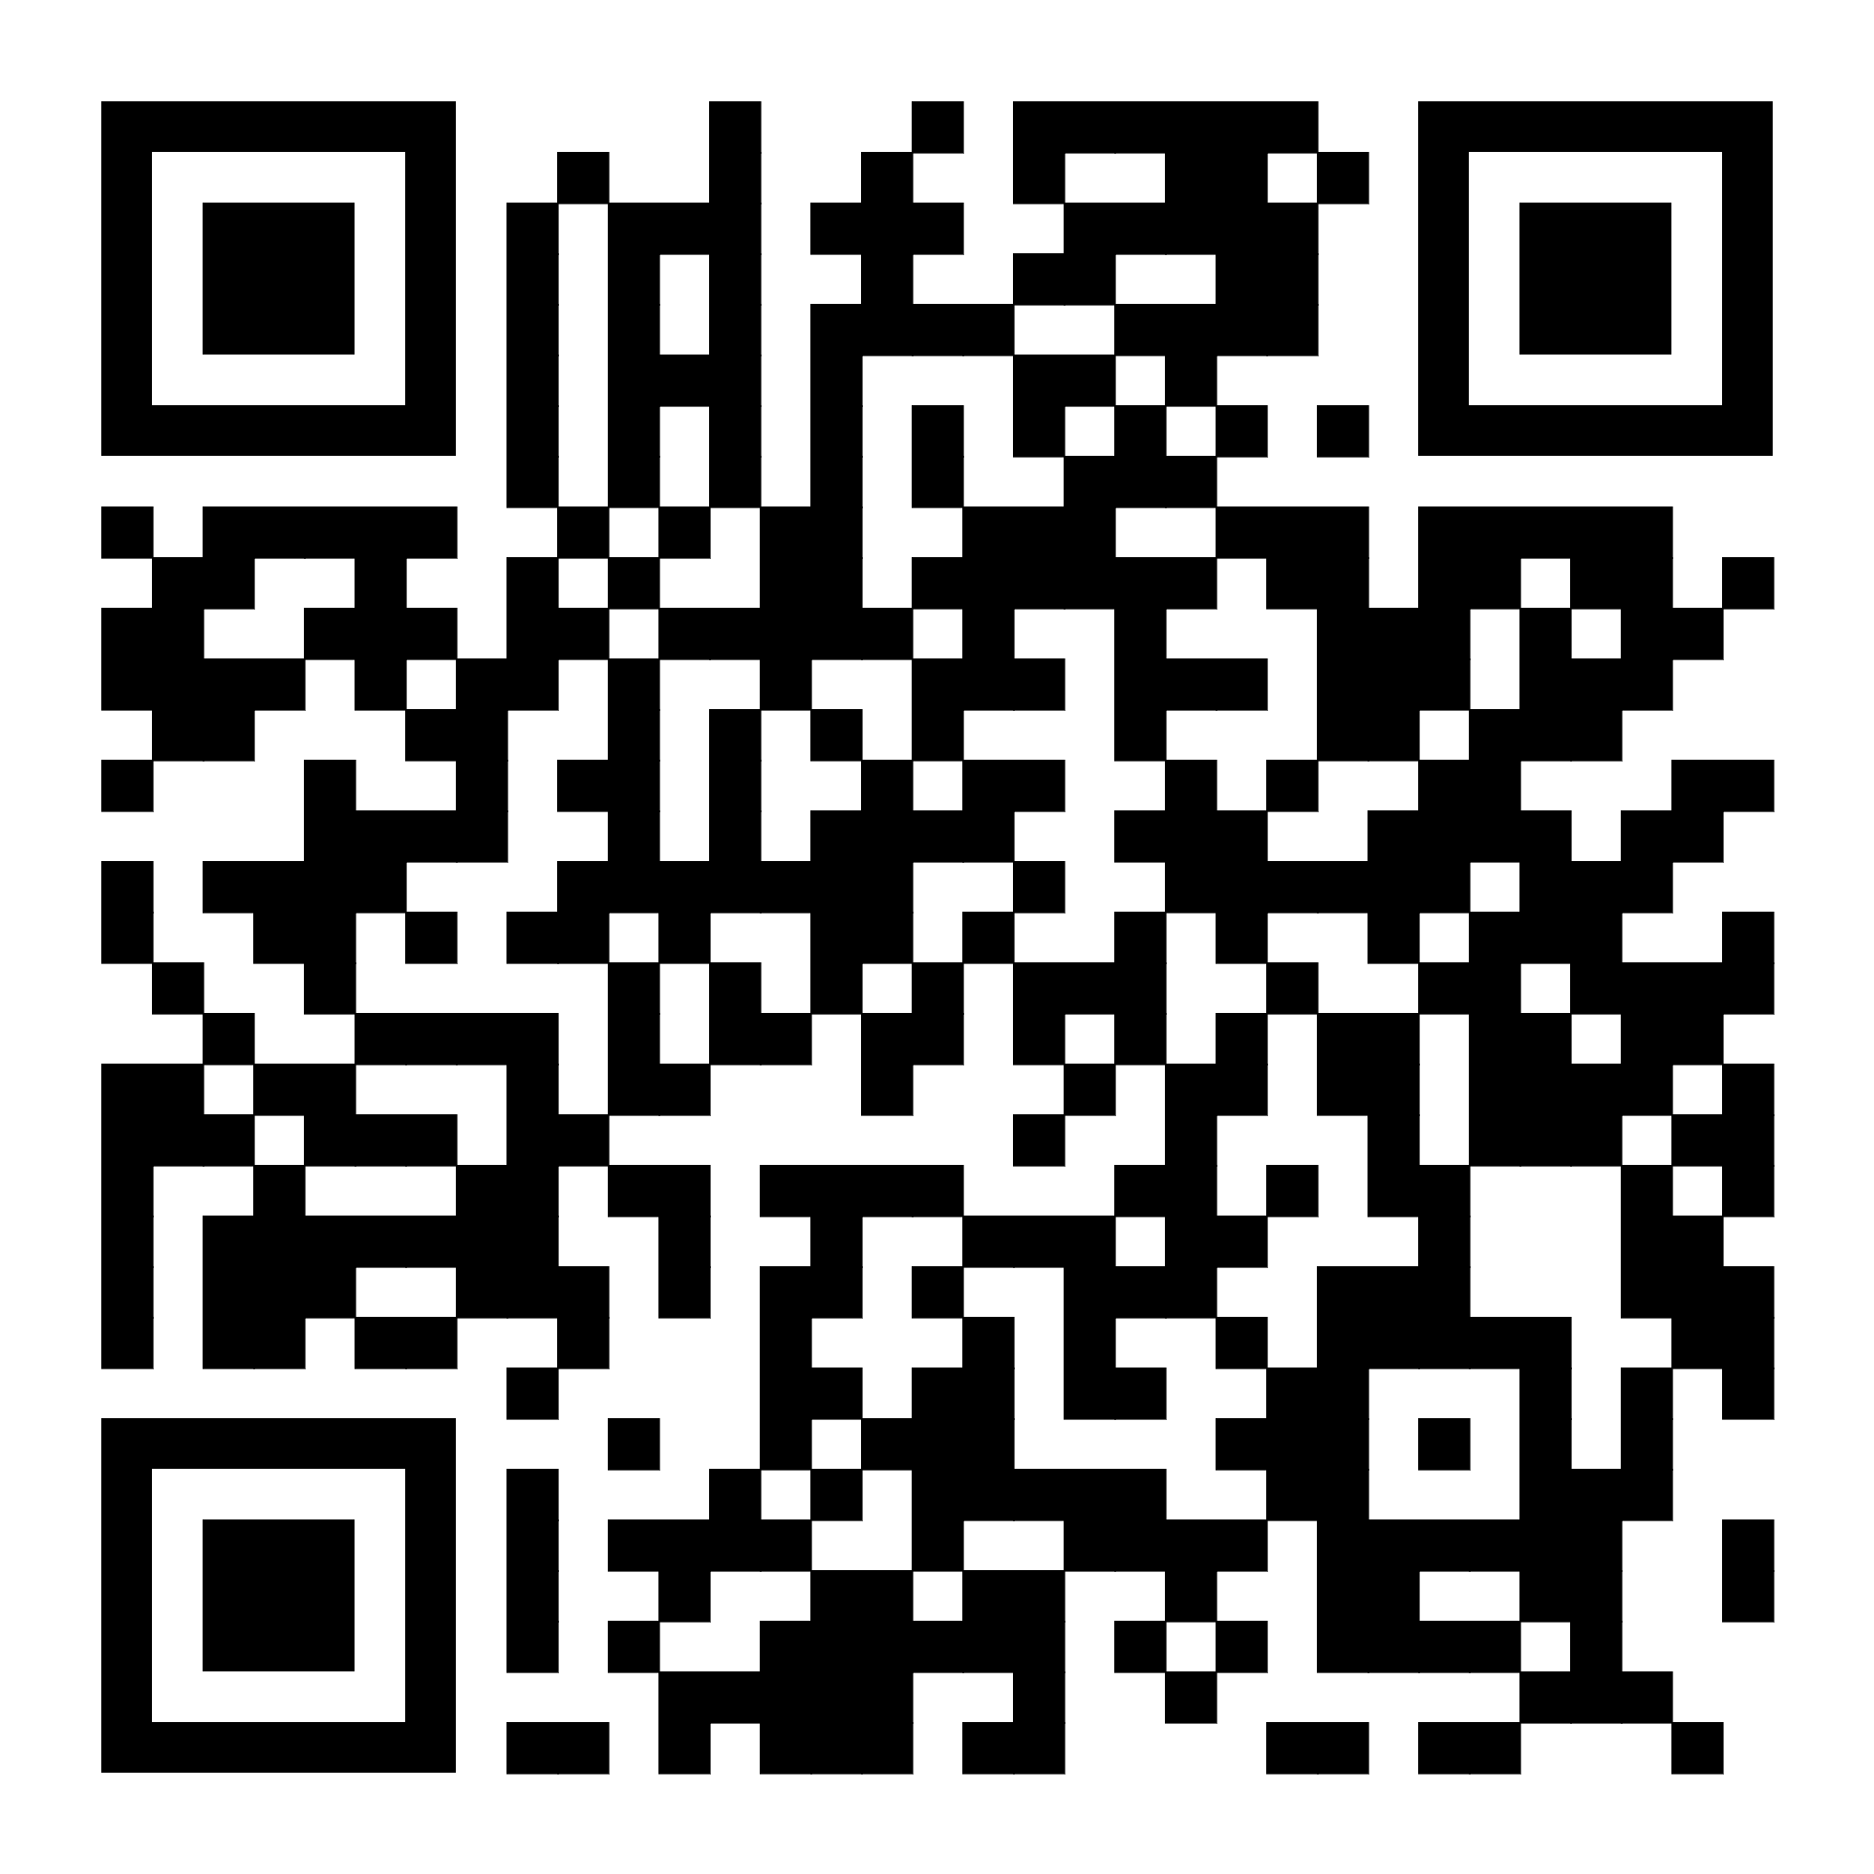

Slide 4
Courses for WINTER semester 2025/2026 two courses are compulsory
Modul | Code | Subject | Credits | Teacher contact
Theoretical Modul | OEMNN1701Z | Primary education | 5 credits | jana.stara@pedf.cuni.cz
 | OEMNN1706Z | Pre-primary Education – current trends and challenges in Europe | 5 credits | barbora.loudova@pedf.cuni.cz
Practical Modul | OEMNN1702Z | Teaching practice I | 5 credits | jana.stara@pedf.cuni.cz
Elective courses | OEMNN1704Z | Encouraging creative and innovative thinking in schools | 4 credits | petra.vallin@pedf.cuni.cz

Slide 5

Theoretical Modul: Primary Education
Aim:
The aim of the course is to orient students in the system of primary education and to develop their skills to competently discuss current issues in primary education.
Content:
The course provides an overview of the primary education system.
Students will be introduced to data of a comparative nature as well as recent trends in primary education.
Close attention will be paid to the transition from pre-primary to primary education, support for pupils with a different mother tongue and gifted pupils, preparation of primary school teachers, etc.
When and where? Tuesdays
12:00 - 13:30 in R128+S210.
Teacher: doc. PhDr. Jana Stará, Ph.D.
BEGINNING: 7.10.2025

Slide 6
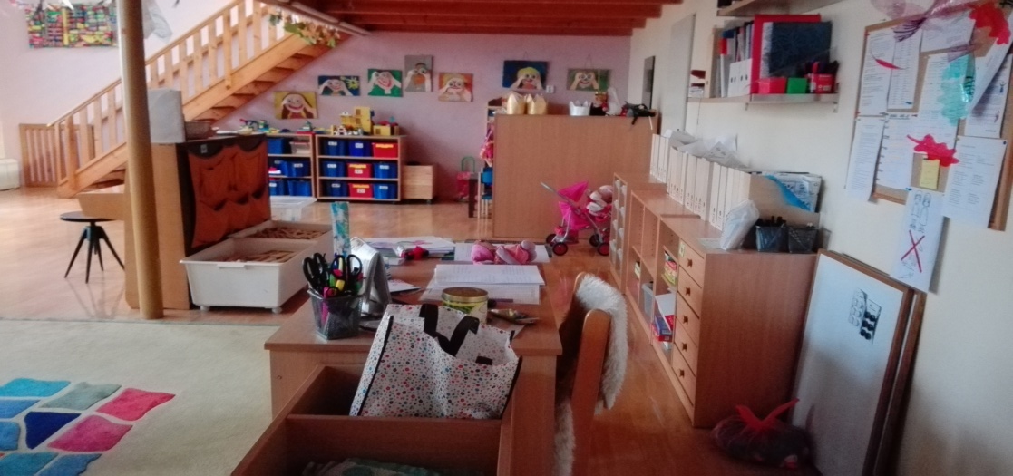
Theoretical Modul:
Pre-primary Education – current trends and challenges in Europe
The course inquiries into current trends and challenges of early childhood education and care in Europe. The course focuses on the diversity of education systems and educational reality in the Czech Republic, in countries of participating students and in other European countries.
Students will be provided with key information on trends and important topics related to current developments in pre-primary education in Europe (structures of ECEC; public policies concerning ECEC and family supporting measures; quality of ECEC; education guidelines; specific language support measures for children; outcomes, assessment and reporting; professionalization).
When and where? Mondays, 8:55 - 10:35 in R010B
Teacher: PhDr. Barbora Loudová Stralczynská, Ph.D.
BEGINNING: 6.10.2025

Slide 7
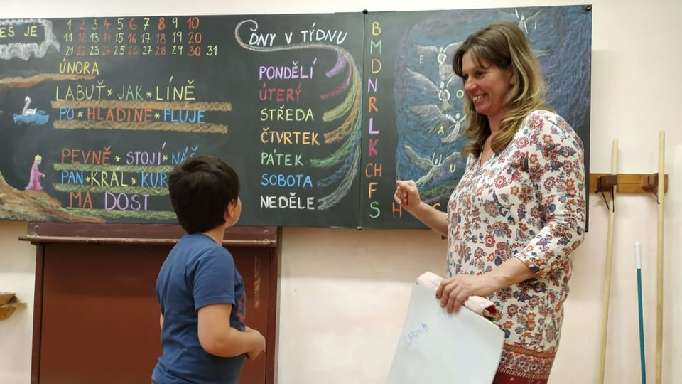
Practical Modul: Teaching Practice I
Aims:
To have a good understanding of Czech pre-primary and primary education in the European context.
To consider how new knowledge and comparative experiences can improve practice as a teacher
Content:
Observe teaching and learning in Czech schools and complete a reflective diary.
Participate in presentations and group discussions led by the course tutor.
Plan and teach a short English language activity to a small group of children.
Complete independent study tasks on Moodle (readings, videos, etc.)
When and where? Tuesdays, 8:00 - 11:00 in pre-/primary schools, every even week
Teacher: doc. PhDr. Jana Stará, Ph.D. and co. The first meeting will be on 30.10.; 14.10.; 11.11.; 25.11.; 9.12.2025. SMIMO = school (address will be announced)

Slide 8
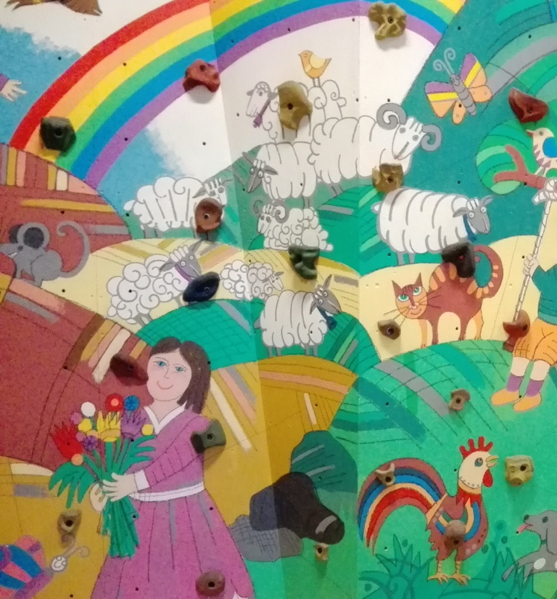
Encouraging creative and innovative thinking in schools
The course will help students to unlock, discover and release their creative potential and will present them with methodologies that can be applied in classroom setting. Participants will learn about using ITC, different forms of arts, reading and writing, questioning and other techniques to foster creativity in schools. The course is designed as a series of workshops that are composed of hand-on activities, practical tips, and the final creative project.
Presentation introducing the final creative project
PhDr. Petra Vallin, Ph.D.
Encouraging creative and innovative thinking in schools OEMNN1704Z
When and where? even Mondays, 11:40 - 14:40 in R122 / R218 of M. Rettigové building, every even week, BEGINNING on 13.10.2025

