Slide 1
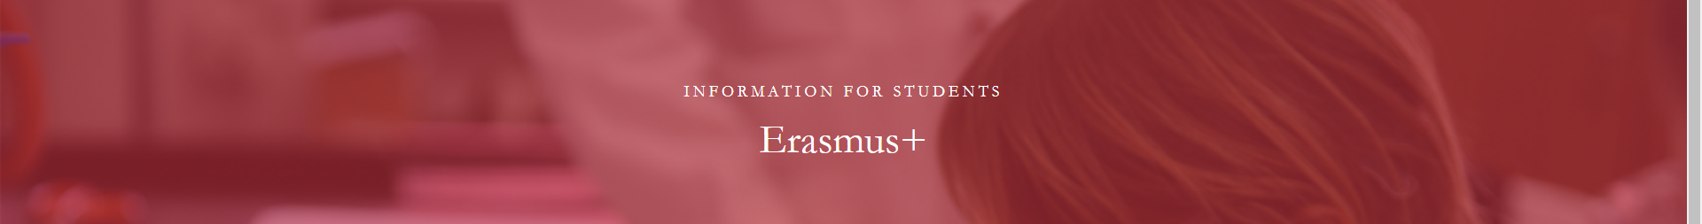

Erasmus info meeting
Department of pre-primary and primary education
COURSES
WINTER SEMESTR 2024/2025

Slide 2
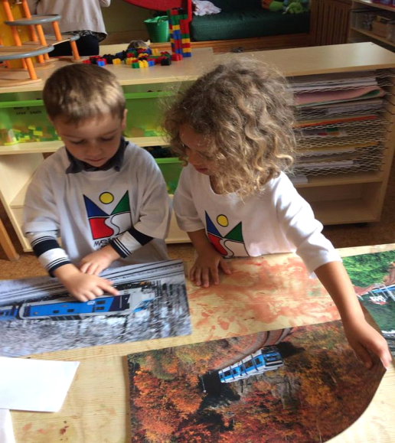
Contact person and information
Department of pre-primary
and primary education
PhDr. Barbora Loudová Stralczynská, Ph.D. (R223) barbora.loudova@pedf.cuni.cz
DEPARTMENTAL MEETING:
WEDNESDAY, October 2
9:30-10:30 A.M.
ROOM: S210

Slide 3
Courses for WINTER semester 2024/2025 two courses are compulsory
Modul | Code | Subject | Credits | Teacher contact
Theoretical Modul | OEMNN1701Z | Primary education | 5 credits | jana.stara@pedf.cuni.cz
 | OEMNN1706Z | Pre-primary Education – current trends and challenges in Europe | 5 credits | barbora.loudova@pedf.cuni.cz
Practical Modul | OEMNN1702Z | Teaching practice I | 5 credits | jana.stara@pedf.cuni.cz
Elective courses | OEMNN1704Z | Encouraging creative and innovative thinking in schools | 4 credits | petra.vallin@pedf.cuni.cz
 | OEMNN1711Z | Young Children’s Worlds | 5 credits | philip.selbie@pedf.cuni.cz
 | OEMNN2401Z | Historical thinking in pre-primary and primary education - methodological approaches and practice | 5 credits | jana.stara@pedf.cuni.cz, iva-berankova@pedf.cuni.cz

Slide 4
Courses for SUMMER semester 2024/2025 two courses are compulsory
Modul | Code | Subject | Credits | Teacher contact
Theoretical Modul | OEMNN1701Z | Primary education | 5 credits | jana.stara@pedf.cuni.cz
 | OEMNN1706Z | Pre-primary Education – current trends and challenges in Europe | 5 credits | barbora.loudova@pedf.cuni.cz
Practical Modul | OEMNN1708Z | Teaching practice II | 5 credits | petra.ristic@pedf.cuni.cz
Elective courses
 | OEMNN1712Z | Inclusive Education and multiculturalism | 4 credits | petra.vallin@pedf.cuni.cz
 | OEMNN2401Z | Historical thinking in pre-primary and primary education - methodological approaches and practice | 5 credits | jana.stara@pedf.cuni.cz, iva-berankova@pedf.cuni.cz

Slide 5

Theoretical Modul: Primary Education
Aim:
The aim of the course is to orient students in the system of primary education and to develop their skills to competently discuss current issues in primary education.
Content:
The course provides an overview of the primary education system.
Students will be introduced to data of a comparative nature as well as recent trends in primary education.
Close attention will be paid to the transition from pre-primary to primary education, support for pupils with a different mother tongue and gifted pupils, preparation of primary school teachers, etc.
When and where? Tuesdays
11:30- 13:00 in R010A.
Teacher: doc. PhDr. Jana Stará, Ph.D.

Slide 6
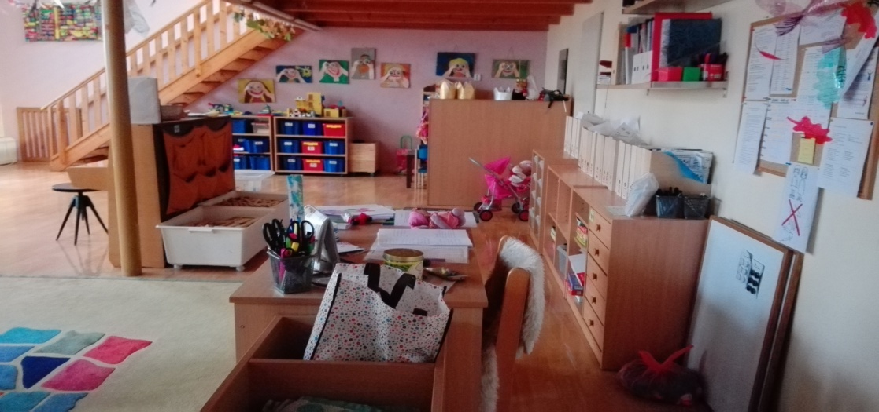
Theoretical Modul:
Pre-primary Education – current trends and challenges in Europe
The course inquiries into current trends and challenges of early childhood education and care in Europe. The course focuses on the diversity of education systems and educational reality in the Czech Republic, in countries of participating students and in other European countries.
Students will be provided with key information on trends and important topics related to current developments in pre-primary education in Europe (structures of ECEC; public policies concerning ECEC and family supporting measures; quality of ECEC; education guidelines; specific language support measures for children; outcomes, assessment and reporting; professionalization).
When and where? Thursdays, 8:55 - 10:35 in SMALL HALL and facultative online within a BIP programme 16:00-18:00
Teacher: PhDr. Barbora Loudová Stralczynská, Ph.D.

Slide 7
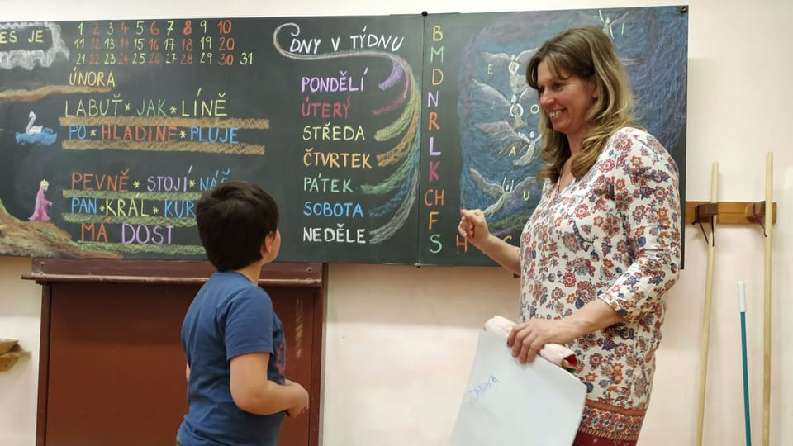
Practical Modul: Teaching Practice I
Aims:
To have a good understanding of Czech pre-primary and primary education in the European context.
To consider how new knowledge and comparative experiences can improve practice as a teacher
Content:
Observe teaching and learning in Czech schools and complete a reflective diary.
Participate in presentations and group discussions led by the course tutor.
Plan and teach a short English language activity to a small group of children.
Complete independent study tasks on Moodle (readings, videos, etc.)
When and where? Tuesdays, 8:00 - 11:00 in primary schools, every even week
Teacher: doc. PhDr. Jana Stará, Ph.D. and co. The first meeting will be on 15.10.2024.

Slide 8
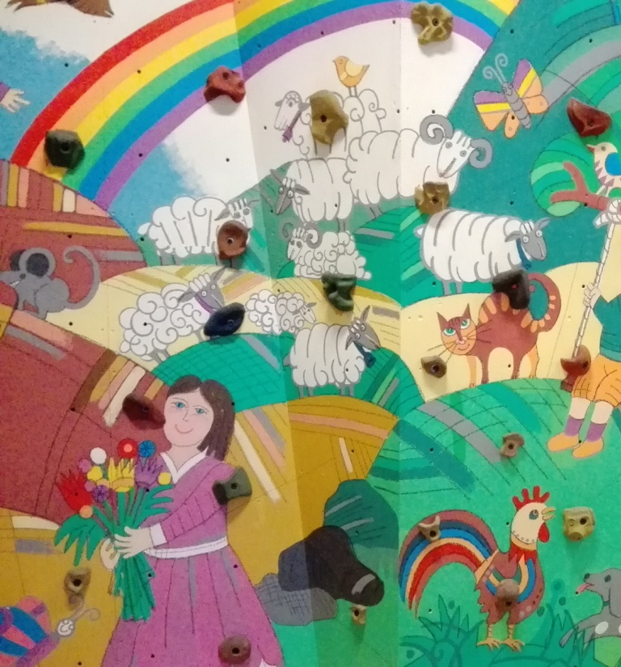
Encouraging creative and innovative thinking in schools
The course will help students to unlock, discover and release their creative potential and will present them with methodologies that can be applied in classroom setting. Participants will learn about using ITC, different forms of arts, reading and writing, questioning and other techniques to foster creativity in schools. The course is designed as a series of workshops that are composed of hand-on activities, practical tips, and the final creative project.
Presentation introducing the final creative project
PhDr. Petra Vallin, Ph.D.
Encouraging creative and innovative thinking in schools OEMNN1704Z
When and where? even Mondays, 14:25 - 17:25 in R122 of M. Rettigové building, every even week.

Slide 9

Young Children’s Worlds
Aim:
The focus of this course is for students to consider how observing young children playing and learning is necessary to support effective learning opportunities as well as children's holistic development.
Students will:
Learn how to observe, assess and record young children’s learning.
Reflect upon their own professional practice with children.
Recognise the importance of high-quality early learning as a foundation for future learning.
Learn (a little) about some historical pioneers of early childhood education and theories of learning.
Complete short independent study tasks on Moodle (based on readings, podcasts, videos, etc).
Assessment:
An assessed task will be agreed with the students during the course.
When? Monday mornings from 7 October to 16 December (10.45 to 12.15).
Where? Malý sál in the basement of the M. Rettigové 4 building.

Slide 10

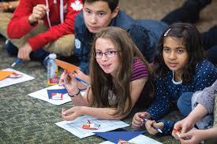
Historical thinking in pre-primary and primary education - methodological approaches and practice
Aim:
The aim of the course is to equip students with the knowledge and didactic skills to develop in preschool and early school-age children historical thinking, the ability to perceive their surroundings, cultural specifics and differences, how to work with cultural universals and use primary sources in education. The introduction to Inquiry-based Learning in pre-primary and primary education is included.
Content:
The course seeks to develop students' existing knowledge of strategies and methods effective for children's social studies and history education (comparing and simply analyzing artifacts, interviewing a family member, observing people's behavior, working with a story). It also includes 2 meetings as an example of teaching outside the classroom to show how explore the educational value and potential of informal learning spaces for learning, for e.g,. the historical centre of the town (village), in memory institutions, as well as working with landscape and historical memory and landscape memory.
Assessment: Portfolio of a self-designed learning unit for preschool or early school age children.
Teacher: doc. PhDr. Jana Stará, Ph.D. and PhDr. Iva Beránková
When and where? Tuesdays, 15:30 - 17:00 in R0410B, once in 2 weeks

